Slide 1



Research on Genetic Susceptibility of Schizophrenia
The 9th BESETO Conference
Weihua YUE, M.D., Ph.D.
Institute of Mental Health, Sixth Hospital, Peking University
National Clinical Research Center for Mental Disorders, China

Slide 2
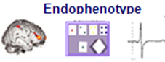

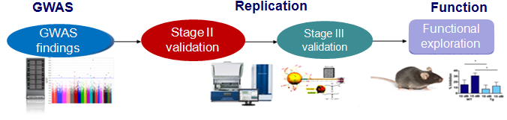
Questions and objectives
Can we find any potential targets of antipsychotic medicines using pharmacogenomics data?
Are there any potential overlapped susceptible loci explaining both risk for disease and therapeutic effects?
What’s potential roles of this novel susceptible genes in the mechanism of schizophrenia?

Slide 3

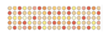
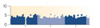
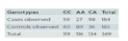
Flowchart of the research
Inclusion criteria
diagnosed as schizophrenia according to DSM-IV (SCID interview) criteria
Aged 18~45 yrs
Han Chinese
Total PANSS score >=60
Written informed consents were obtained
Enrollment of patients
Antipsychotics treatment (6 weeks)
Genotyping (OmniZhongHua 8)
Exclusive Criteria
Severe physical diseases
Severe Lab abnormalities
Treated with ECT over the last month
Severe EPS, TD, malignant syndrome, etc.
GWAS of PANSS reduced rates
Replication in independent cohort
3

Slide 4
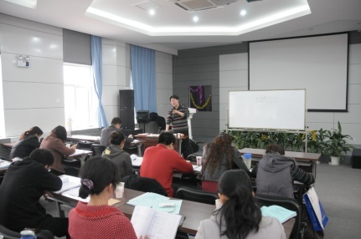
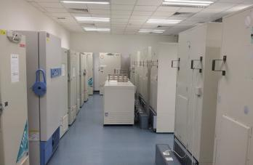
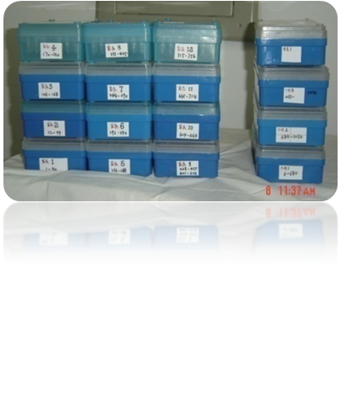
Pharmacogenomic research
Pharmacogenomic exploration
We made a multiple centers, randomized controlled clinical trials in 32 psychiatric hospitals across China.
3,030 cases with schizophrenia with 7 antipsychotic drugs followed-up for 6 weeks. Response rate ~63.4%, incidence of adverse reactions ~58.6%.
2,794 cases were genotyped with the Illumina Human Omni ZhongHua-8 BeadChip.
1,379 independent cases were genotyped with Illumina 610K & 660K Beadchip (3 antipsychotics, follow-up 8 weeks).
4

Slide 5
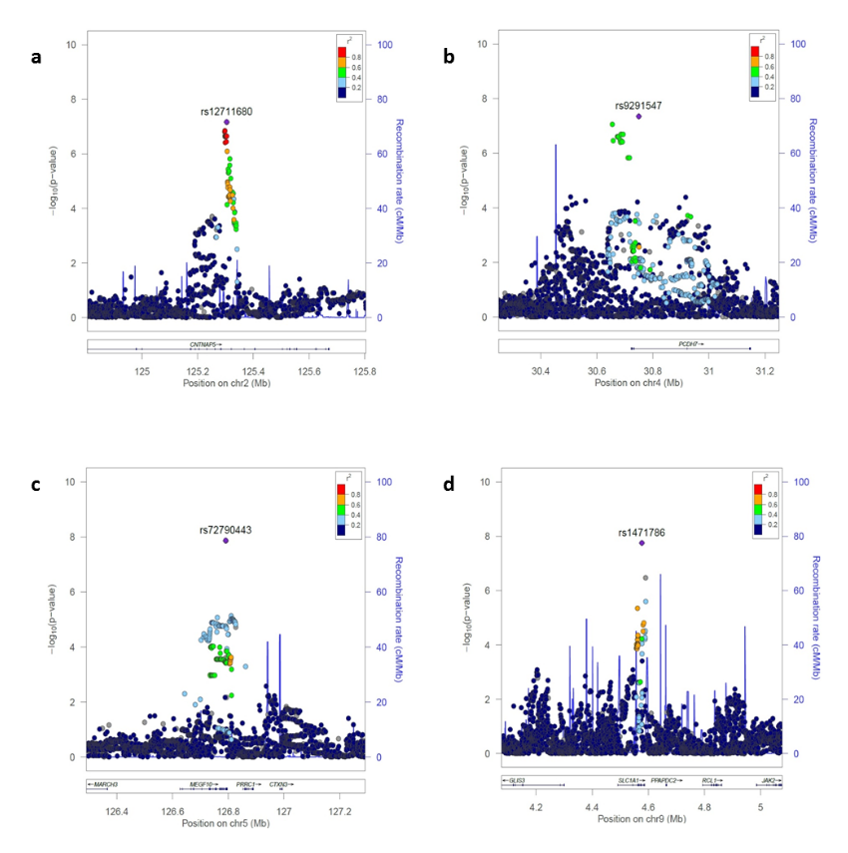
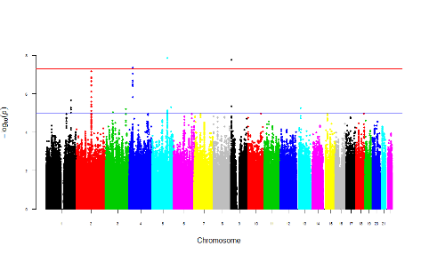
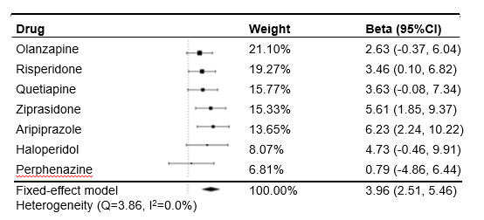
Pharmacogenomics of antipsychotic treatment (therapeutic effects)
SLC1A1, PCDH7, MEGF10, CNTNAP5, and TNIK polymorphisms associated with PANSS reduced rates after 6-week treatment of antipsychotic drugs (APDs)
Different APDs showed various ORs to therapeutic effects of different genes
Discriminative power to distinguish responders from non-responders (AUC 71.3%).
SLC1A1 rs1471786
SLC1A1 PCDH7 MEGF10
CNTNAP5 TNIK
SLC1A1 rs1471786
Yu et al., Lancet Psychiatry 2018

Slide 6
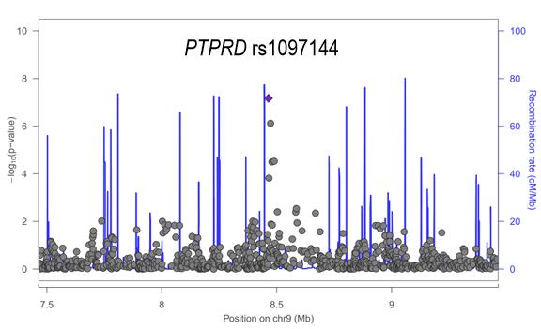
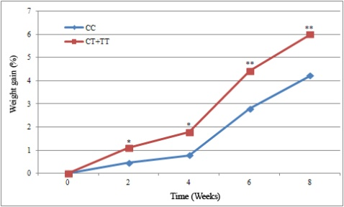
Pharmacogenomic research (side effects, AIWG)
GWAS suggested the PTPRD, GFPT2, ACTR3 polymorphisms associated with antipsychotic induced weight gain (AIWG)
1,081 schizophrenia patients following 8-week treatment with atypical antipsychotic drugs
PTPRD rs10977144 T allele demonstrating risk effects of weight gain related to APDs (P_{GWAS} = 6.82×10⁻⁸; P_{Replicated} = 4.32×10⁻³); combined analysis revealed a genome-wide significant effect (P_{Combined} = 7.53×10⁻⁹).
Other susceptible genes with weight gain including, A2BP1, GFPT2, SLC6A4, FTO, ABCB1, etc.
PTPRD rs10977144
PTPRD, GFPT2, ACTR3
Yu et al., Schizophr Bull 2016; Wang et al., Pharmacogenomics 2015; Dong et al., Pharmacological Res 2015; Yu et al., Am J Psychiatry (in submission)

Slide 7
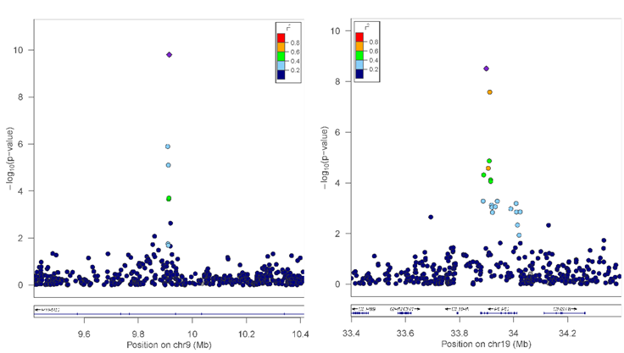
Pharmacogenomic research (side effects, AIWG)
Further exploration on roles of susceptible genes of diabetes in AIWG?
Discovery: 2382 patients with schizophrenia (from the CAPOC project); 7 antipsychotic drugs, follow-up 6 weeks
Validation: 538 patients with schizophrenia (independent cohort); 4 antipsychotic drugs, follow-up 8 weeks
PTPRD rs10978083
PEPD rs731839
protein tyrosine phosphatase, receptor type D (PTPRD); peptidase D (PEPD)
Zhuo et al., Front Pharmacol, 2018; Yu et al., Mol Psychiatry, submitted
7

Slide 8
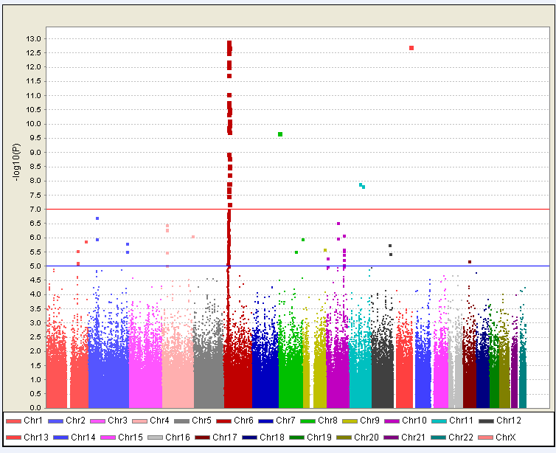
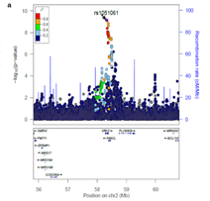
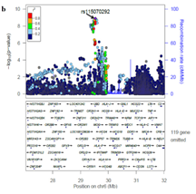
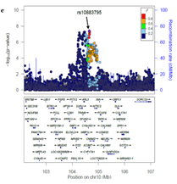
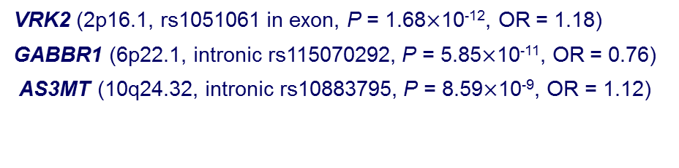
Meta analysis of GWAS data across different populations to find risk genes of schizophrenia
Common variants on 2p16.1, 6p22.1 and 10q24.32 associated with susceptibility to schizophrenia in using GWAS-based meta analysis across populations; providing new insights into pathways (GABA, DA, etc) contributing to the susceptibility for schizophrenia in Chinese Han population.
GWAS: 4,384 schizophrenia v.s. 5,770 healthy controls of Chinese Han, Japanese, and Caucasian ancestry;
Replication: 4,339 schizophrenia v.s. 7,043 controls of Chinese Han.
Polygenic risk score calculated using PGC data modestly predicted case-control status in Chinese population (Nagelkerke R² 1.7-5.7%).
Yu et al., Mol Psychiatry. 2017
Notes:
Vaccinia-related kinase 2 (VRK2). VRK2 gene expression in schizophrenia, bipolar disorder and healthy controls.
Tesli et al. Br J Psychiatry. 2016 Mar 3.
including GABAergic signaling, dopaminergic signaling, cell adhesion molecules, myelination and neurotrophin signaling pathway.
human-specific arsenite methyltransferase (AS3MT)

Slide 9
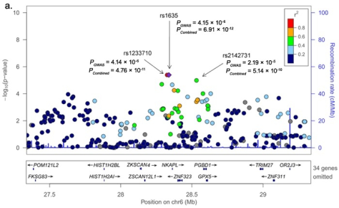
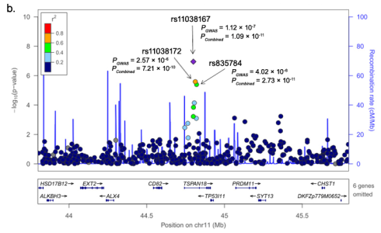
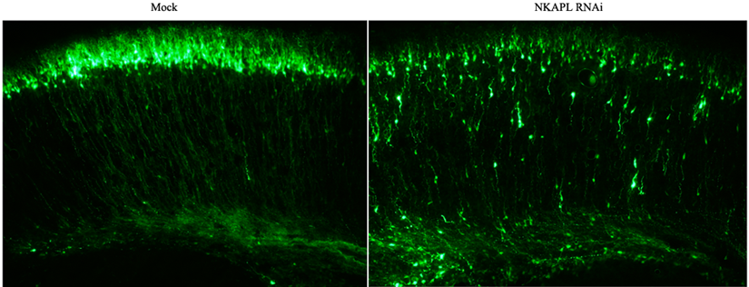
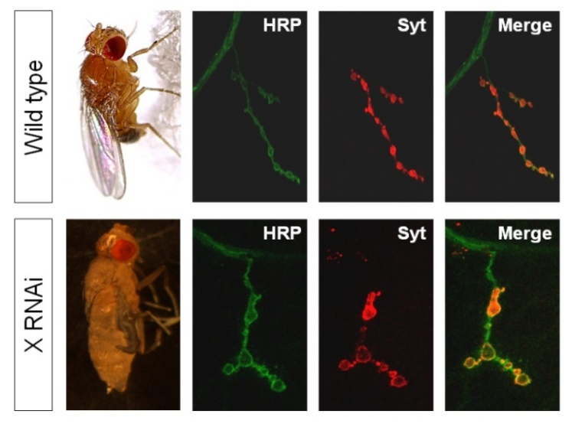
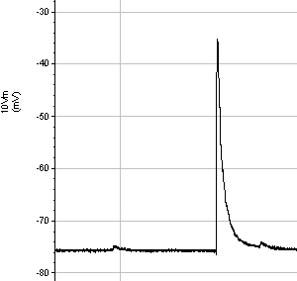
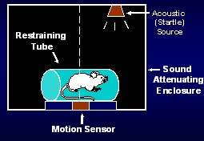
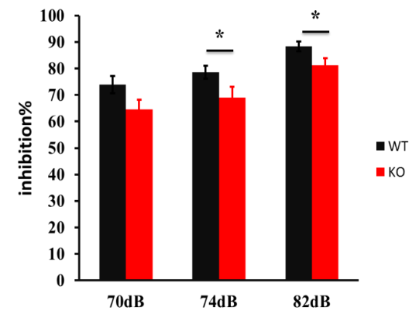
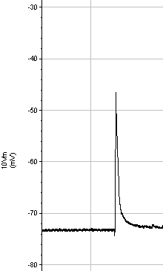
Potential roles of novel susceptible genes of schizophrenia
6p22.1 (MHC): NFKB activating protein-like (NKAPL); zinc finger with KRAB and SCAN domains 4 (ZKSCAN4); piggyBac transposable element derived 1 (PGBD1)
11p11.2: Tetraspanin 18 (TSPAN18)
During the developing cortex, shRNA inhibited the neuronal migration and projection. Utero electroporation: E14.5 brains were electroporated with control or shRNA and analyzed at P0.
Abnormal prepulse inhibition (PPI) in NKAPL (6p22.1) homogene KO mice
Abnormal synaptic structure and transmission
Yue et al., Nat Genet 2011; Chen et al., Nat Commun (in revision)
9
Notes:
提示与脑发育和认知功能密切相关 4795cases vs 7335HC

Slide 10
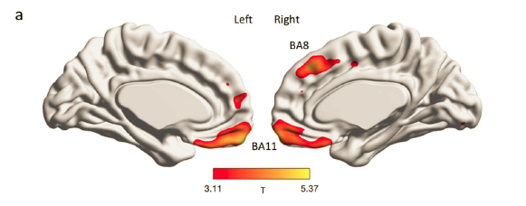
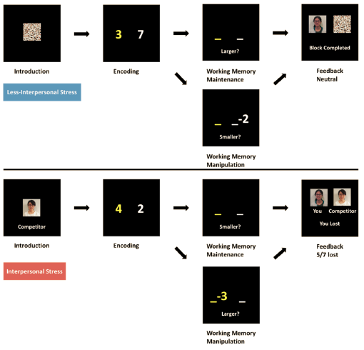
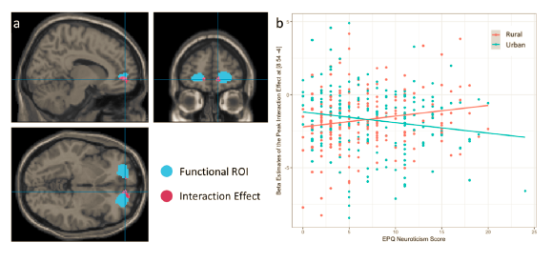
Effects of urban and rural childhoods environment on individual’s imaging features
Subjects with rural childhoods had relatively increased medial prefrontal cortex (mPFC) gray matter volumes.
The engagement of mPFC during working memory was relatively reduced under increased interpersonal stress.
Increased trait anxiety and depression was associated with reduced stress-related mPFC engagement but only in subjects with urban childhoods.
Zhang et al., Schizophr Bull 2022; Cheng et al., Cereb Cortex 2021
Notes:
Schematic of the working memory paradigm incorporating interpersonal stress vs less stress. In the stress component, subjects were led to believe they were playing against a “competitor” of the similar age and gender, and were judged win or lose based on their speed and accuracy, which subsequently resulted in ~70% loss feedback. In the less stressed blocks, there was no competitor and subjects would receive a neutral feedback. In the working memory task per se, an array of two number digits was encoded and held in working memory over 3-4s. In working memory manipulation, subjects were to perform subtraction arithmetic on one of the numbers held in working memory, followed by answering which was larger or smaller as instructed. In working memory 587 maintenance, they answered which of the two maintained in working memory was larger or smaller as instructed. We performed 2 runs counterbalanced for trial and stimuli presentation order over ~20 mins. All instructions were showed in Chinese.
In this report on interpersonal stress and trait anxiety-depression on brain, we used a validated Chinese translation of the Eysenck Personality Questionnaire (EPQ) to study trait neuroticism

Slide 11
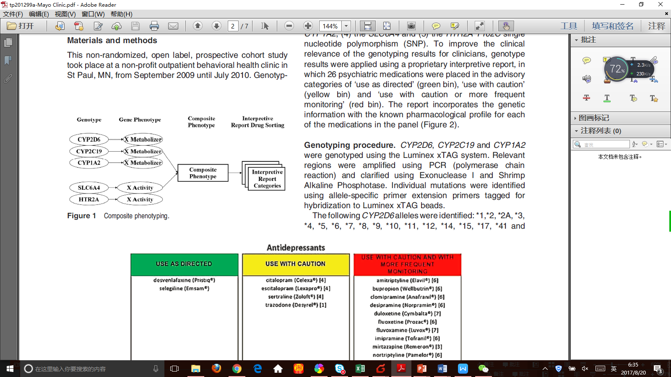
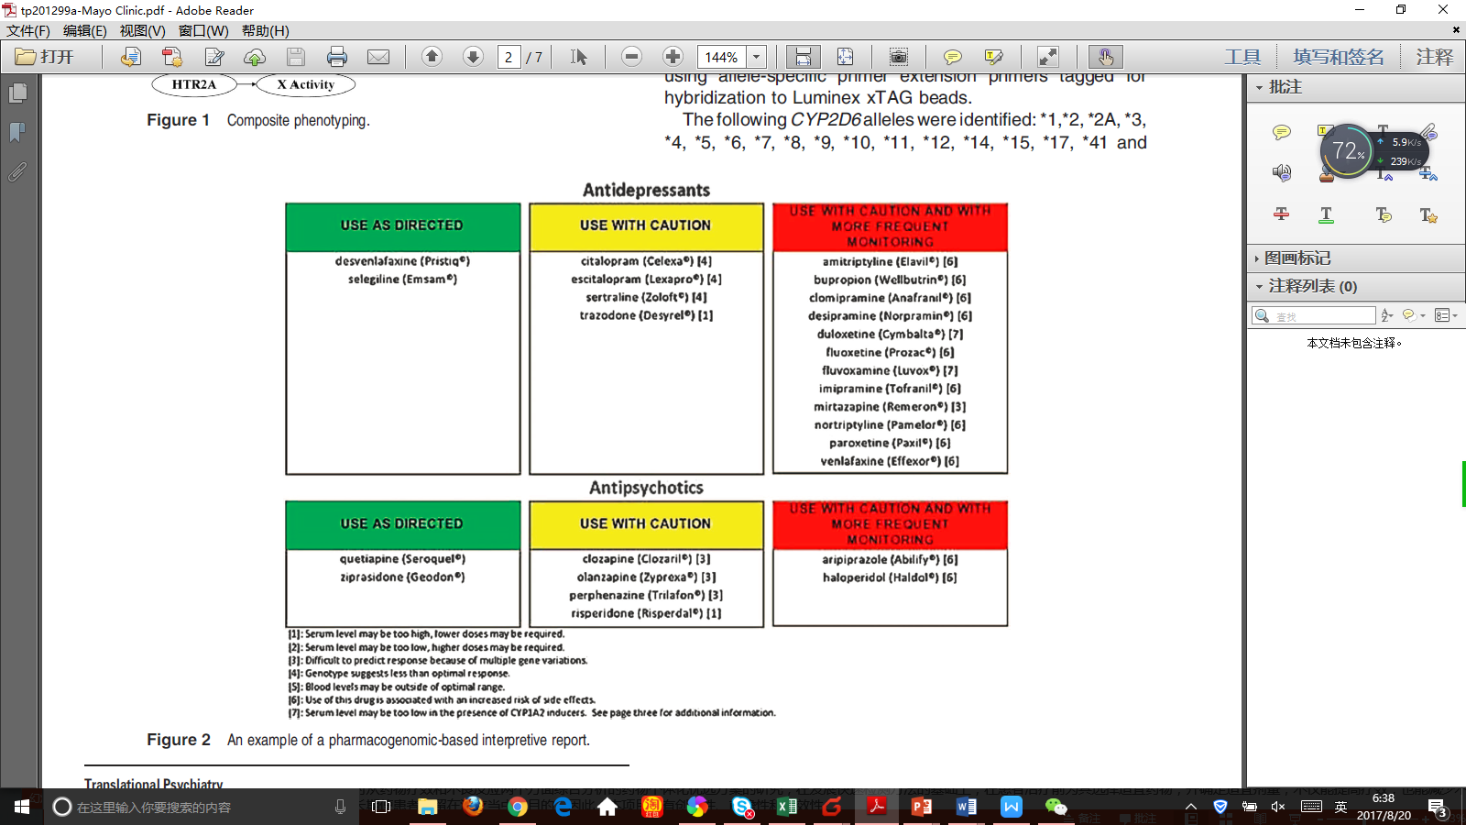
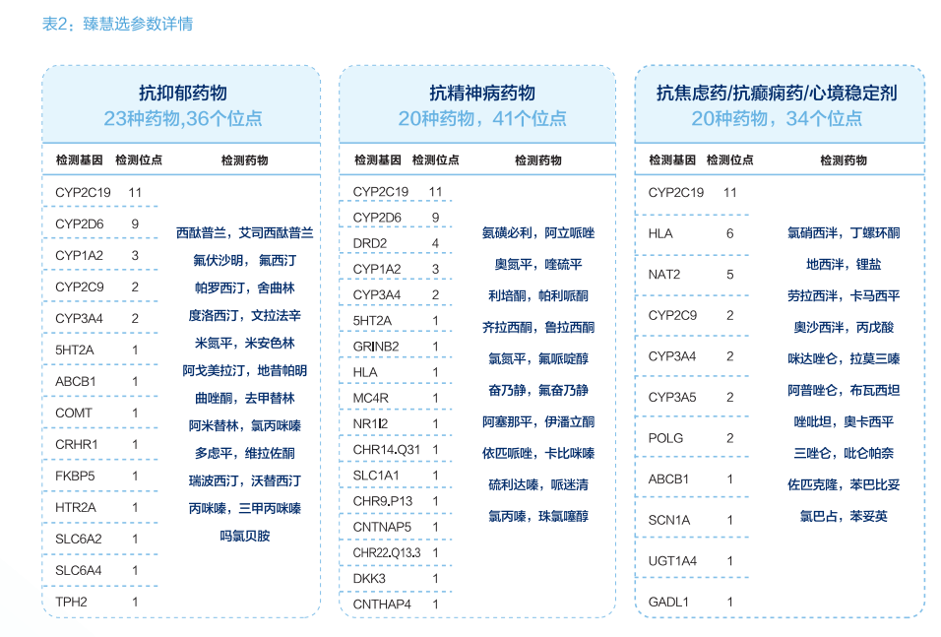
Pharmacogenomics-Guided Pharmacotherapy of Schizophrenia in Chinese Han Schizophrenic Patients: A Randomized Controlled Trial
A total of 171 patients were enrolled in this study and 157 patients who had at least one follow-up assessment were included in the intend-to-treat (ITT) analysis.
Patients in PGT group had a greater early-response rate (96.4% v.s. 85.1%) at week 2, response rate (91.6% v.s. 67.6%) at week 6, and symptomatic remission rate (77.1% v.s. 59.5%) at week 12, compared to TAU group.
Genes Loci Genes Loci
Hall-Flavin et al., Transl Psychiatry 2012; Unpublished data

Slide 12
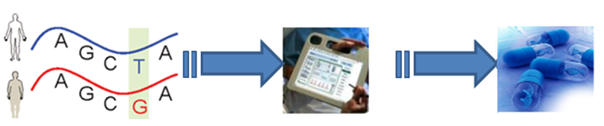
Conclusions
We found five novel significant loci (SLC1A1, PCDH7, MEGF10, CNTNAP5, TNIK) were associated with therapeutic effects of antipsychotics in Chinese Han. Discriminative power of multi-genes to distinguish responders from non-responders (AUC 71.3%).
Several susceptible genes related to glucose metabolism (PTPRD, GFPT2, ACTR3, PEPD) were associated with AIWG
Multi-omics strategies should be helpful to explain the potential mechanism of antipsychotics or risk for schizophrenia.
Then, how about the hypothesis of dopaminergic hyperfunction in schizophrenia? Should we explain that synapse transmission may also play key roles in pharmacological mechanism in schizophrenia?
Genetics examination
Objective diagnosis
Individualized therapy
12

Slide 13


Thanks for your attention
We look forward to our academic collaborations

